Slide 1




AI INTEGRATED LIBRARY MANAGEMENT SYSTEM
Presented By:
Priyanshu Solanki : 2403031057129
Yatharth Chavda : 2303031050529
Abhishekh Dalvi : 2303031050793
Meeth Satadiya : 2303031050529
Supervised by:
Prof: Vikas Dubey Sir.

Slide 2
OUTLINE
Introduction
Objectives of Project Work
Literature Survey
Research Gap
Problem Statement
Tools and Technology
Core Algorithms (Search & Recommendation)
Data Set / Schema Description
System Architecture
Implementation with Results
Role-Based Access Control & Verification
Conclusion & Future Work
References

Slide 3
Introduction
University libraries have historically relied on legacy OPAC systems that catalogue books using static keyword indexing, offering no semantic search capability and no personalized guidance for readers.
Manual spreadsheet updates, physical logs, and overnight batch jobs are still commonly used to track transactions, due dates, and overdue fines — creating administrative overhead and delays in fine enforcement.
AI-Lib addresses this gap with a decoupled, role-based library management platform: a Flask + SQLAlchemy backend exposing REST APIs, paired with an NLP-based semantic search engine, a genre-affinity recommendation module, and real-time (not batch) fine computation.

Slide 4
Objectives of PROJECT Work
Build a role-based library management platform (Admin, Librarian, Student) that replaces manual/legacy workflows with a live client-server system.
Implement an NLP-based semantic search engine so students can find relevant books even with vague, natural-language queries.
Implement an adaptive recommendation engine that personalizes suggestions using each student's borrowing history and genre affinity.
Automate fine computation in real time at return time, rather than through nightly batch reconciliation.

Slide 5
Literature Review
Sr. No. | Paper Title | Journal with Year | Methods | Outcomes
1 | A Hybrid Semantic Indexing Model for Catalog Classification and User-Tag Retrieval | J. Library & Info. Sci. Research (2022) | Hybrid keyword + tag-based indexing | Improved retrieval rate but suffered index fragmentation on nested search patterns.
2 | Collaborative Filtering Recommendation Networks from Historical Student Checkout Data | IRJ Modernization Engg. (2024) | Collaborative filtering on checkout history | Struggled with the 'cold-start' problem for new students or newly added books.
3 | Decoupled RESTful API Transaction Loops for High-Concurrency Library Inventory Systems | J. Web Engg. & Software Arch. (2025) | RESTful decoupled API, client-side caching | Lowered database lock conditions but required heavy client-side caching for fluid transitions.
4 | TF-IDF Weighted Retrieval Layers for Legacy OPAC Modernization | J. Info. Retrieval Systems (2023) | TF-IDF weighted scoring layer | Retrieval precision improved substantially for multi-word queries over legacy OPAC forms.
5 | Real-Time versus Batch Reconciliation for Automated Fine and Penalty Systems | J. Financial Software Engg. (2025) | Event-driven real-time computation | Eliminated nightly grace-period exploits by calculating overdue penalties at return time.

Slide 6
Research Gap
Contextual Search Limitations: Most entry-level library platforms rely on direct SQL LIKE queries and fail on natural-language, multi-word search intent.
Rule-Based Fine Bottlenecks: Fine calculations are typically batched overnight, letting overdue returns slip through before the batch job executes.
Static Recommendations: Typical systems recommend items using hardcoded category tags or global trends, ignoring a student's current academic focus.

Slide 7
Problem Statement
Legacy catalogue systems cannot interpret natural-language search intent, cannot personalize recommendations to an individual reader's history, and cannot enforce fines the moment a book becomes overdue.
This project designs and implements AI-Lib to solve all three problems together: a token-matching relevance-ranking search engine, a recency-weighted genre-affinity recommender, and an event-driven (real-time) fine engine — all served through a secure, role-based REST API.

Slide 8
TOOLS AND TECHNOLOGY
Backend:
Python 3, Flask (application factory + Blueprints)
SQLAlchemy ORM, SQLite (default) / MySQL (configurable), JWT auth + bcrypt password hashing
Frontend:
Semantic HTML5, Vanilla CSS3 (design tokens, glassmorphism cards)
JavaScript (Promise-based REST client — api.js)
Chart.js for analytics visualizations
Fetch API calls carry a Bearer JWT in the Authorization header

Slide 9
Core Algorithms: Search & Recommendation
Semantic Search — Weighted Relevance Ranking:
A query is tokenized (lowercased, stop-words removed). Each candidate book's title, genre, author, and description are compared against the tokens, with fixed field weights: title x4, genre x3, author x2, description x1.
Each field match contributes weight x (1 + ln(term frequency)), and scores are summed and normalized to a 0-100% relevance score.
Adaptive Recommendation — Genre-Affinity Model:
Each student's past checkouts are grouped by genre, with older checkouts discounted using an exponential recency-decay factor (~70-day half-life).
The genre with the highest decayed weight drives the match score shown for new, unborrowed books in that genre.

Slide 10
Worked Example: Semantic Search Scoring
Query: "coding practices"
Candidate: "Clean Code" by Robert C. Martin (Genre: Technology)
Title match: 0 tokens -> 0 pts
Genre match: 0 tokens -> 0 pts
Description match: "practices", "coding" found -> 2 x weight 1 = 2 pts
Result: surfaced and ranked above books with no token overlap
This lets AI-Lib return relevant results even when the query never appears verbatim in the title — the gap identified in the Research Gap section.

Slide 11
Worked Example: Recommendation Match Scoring
Student: Rahul Sharma (Dept.: Computer Science)
Recent checkouts: "Clean Code" (Technology), "Introduction to Algorithms" (Technology)
Genre affinity after recency-decay weighting: Technology = 0.82, Fiction = 0.11, Science = 0.07
Recommended next: "The Pragmatic Programmer" (Technology, not yet borrowed) -> displayed match score ~ 82%

Slide 12
Data Set Description
FIELD | TYPE | DESCRIPTION
User.id | String (PK) | Unique user ID, e.g. STU001 / LIB001 / ADM001
User.role | Categorical | admin / librarian / student — drives RBAC permissions
User.department | String | Student's academic department (e.g. Computer Science)
Book.isbn | String | Unique ISBN identifying the catalogue item
Book.genre | Categorical | Fiction, Science, Technology, History, etc.
Book.available_copies | Numeric | Copies currently available; decremented on issue, incremented on return
Transaction.issue_date / due_date | Date | Loan issue date and 14-day due date
Transaction.status | Categorical | active / returned / overdue
Fine.days_overdue | Numeric | Days elapsed past the due date at return time
Fine.amount | Numeric | Computed in real time at Rs. 2/day overdue
Fine.status | Categorical | paid / unpaid
Recommendation.match_score | Numeric | Percentage match from the genre-affinity model

Slide 13
Project Flow Chart
Frontend
HTML5 / CSS3 / JS
(role-based pages)
api.js
(Fetch + JWT
Authorization header)
Flask Routes
(Blueprints: auth, books,
transactions, fines)
SQLAlchemy
Models (ORM)
NLP Search &
Recommendation Engine
(TF-IDF-style scoring,
genre-affinity model)
SQLite (default) /
MySQL (DATABASE_URL)

Slide 14
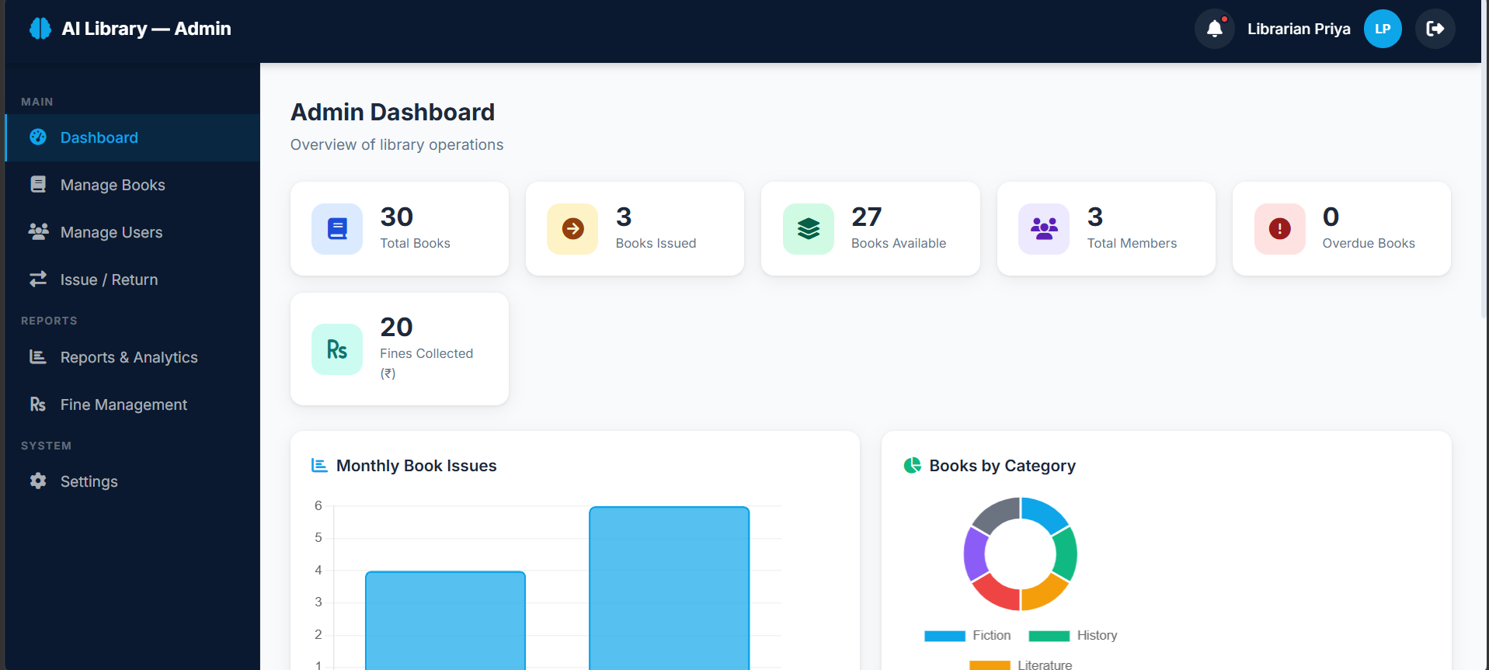
Admin Dashboard Overview
The Admin Dashboard gives a live overview of library operations: total books, books currently issued, books available, total members, and overdue count — all read from the live SQLite/MySQL database via the Flask API, not static or mocked figures.
Chart.js visualizations (Monthly Book Issues, Books by Category) update automatically as new transactions are recorded.

Slide 15
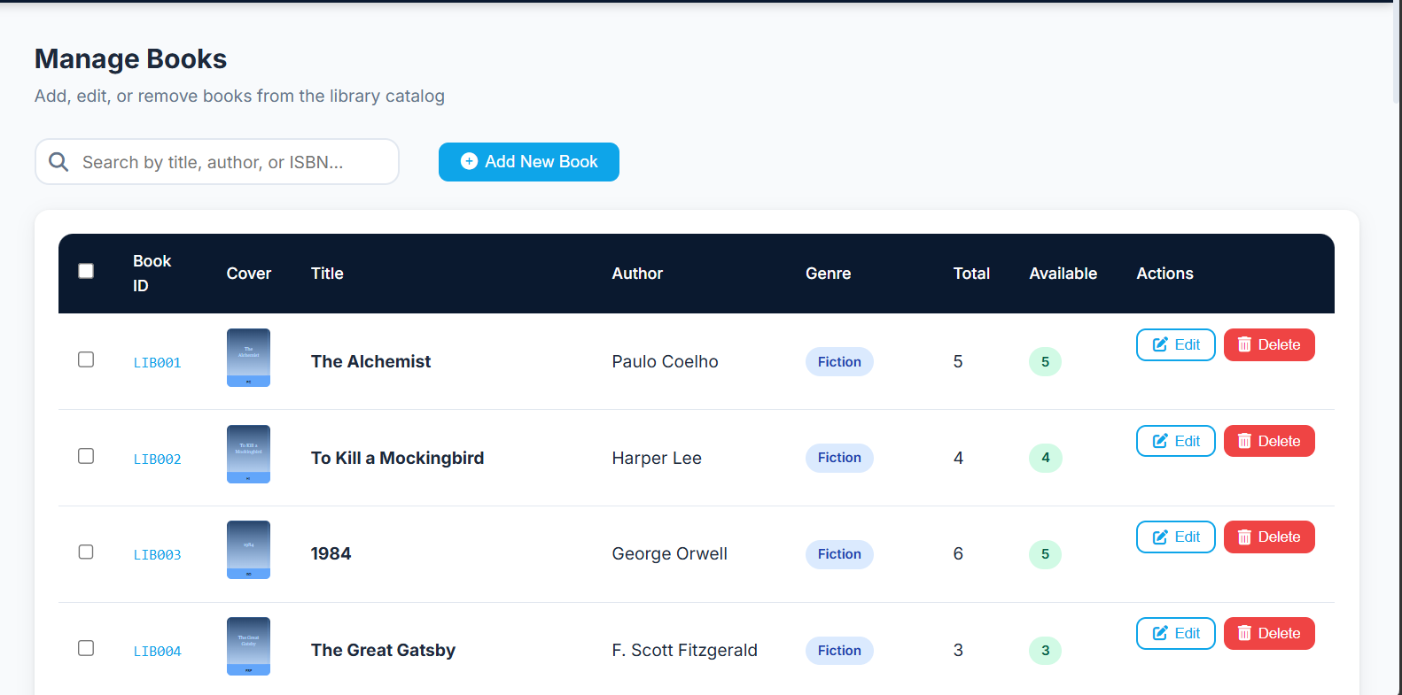
Manage Books (Catalog Management)
Some observations:
Each catalogue entry stores Book ID, title, author, genre, total copies, and available copies — available copies auto-decrement on issue and increment on return.
The search bar filters by title, author, or ISBN using the same token-matching logic as the student-facing search page.
Admins can add, edit, or bulk-delete catalogue entries directly from this screen.

Slide 16
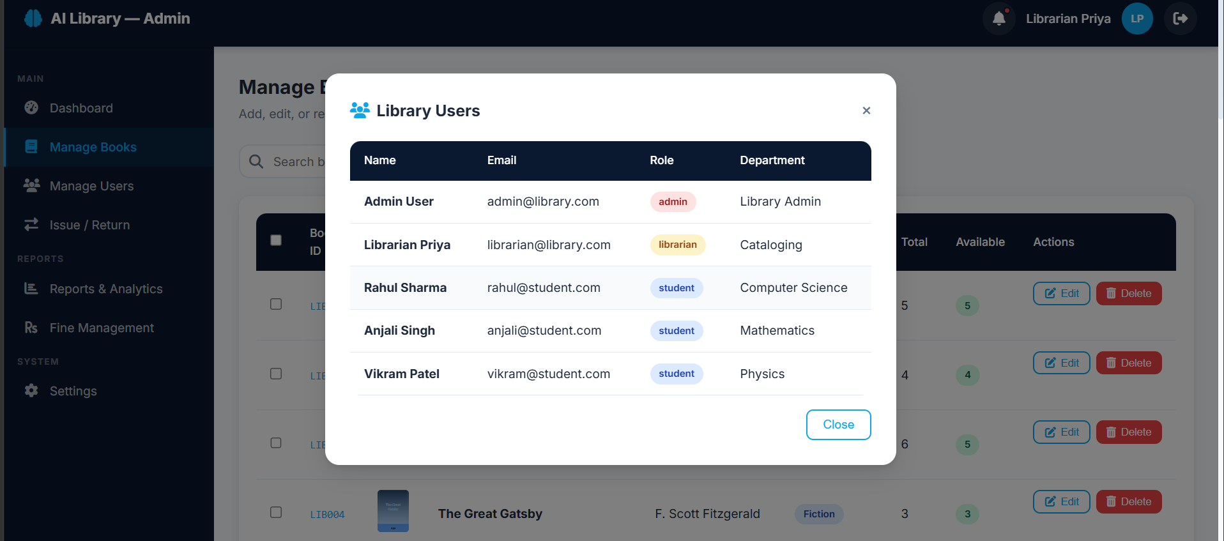
Manage Users & Role-Based Accounts
The Manage Users view lists every account with its assigned role (admin / librarian / student) and department. Role is enforced server-side on every request via the JWT-based token_required and role_required decorators — a student token cannot reach admin-only routes regardless of what the frontend shows.

Slide 17
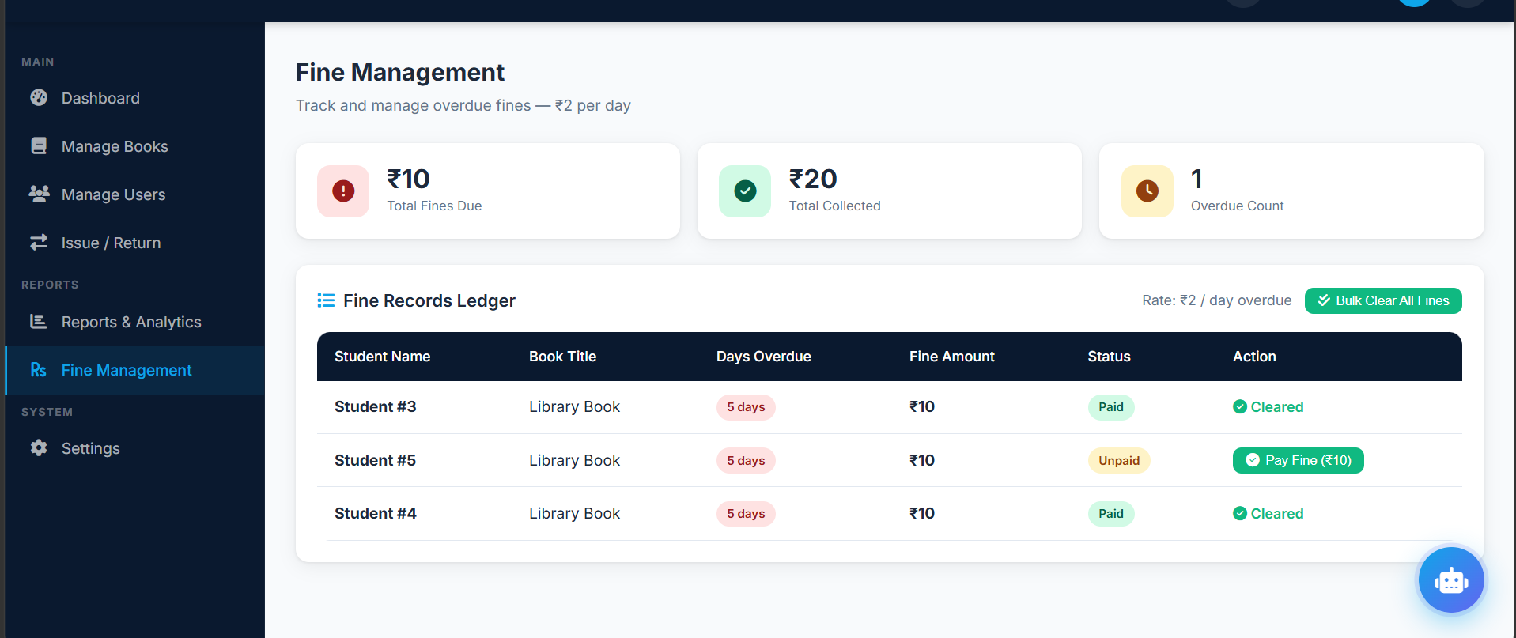
Fine Management (Automated Ledger)
Fines are computed automatically at Rs. 2/day overdue the moment a book is returned late — no overnight batch job is involved.
Librarians can settle individual fines (Pay Fine) or clear all outstanding fines in bulk from this ledger.

Slide 18
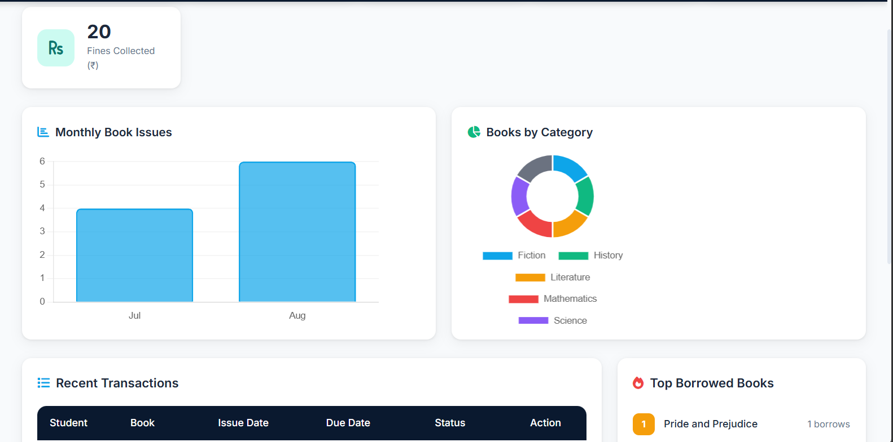
^{Analytics Dashboard}
Monthly Book Issues (bar chart) and Books by Category (donut chart) are rendered with Chart.js, driven by live transaction and catalogue data from the Flask analytics endpoint.

Slide 19
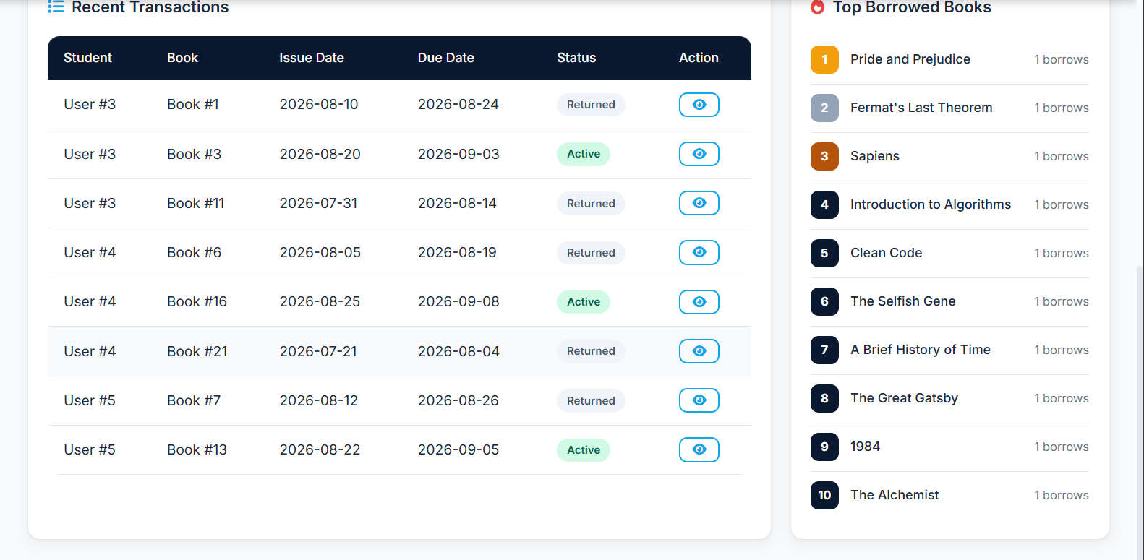
Transactions & Top Books
The transaction log records every issue/return event with issue date, due date, and live status (Active / Returned) — this is the same table the fine engine reads from at return time.

Slide 20
Real-Time Fine Computation
Unlike legacy batch systems, AI-Lib evaluates the overdue penalty the instant a book is returned, using a simple piecewise rule:
Fine(d) = 0 days, if d <= Due Date
Fine(d) = Rs. 2 x (d - Due Date), if d > Due Date
where d is the return date and the loan window is fixed at 14 days from issue.
This removes the overnight grace-period gap that lets legacy systems miss overdue fines when a book is checked in before the nightly batch job runs.

Slide 21
RBAC Matrix
Capability | Admin | Librarian | Student
Manage user accounts & permissions | Yes | No | No
Manage book catalogue | Yes | Yes | No
Authorize issue & return transactions | Yes | Yes | No
View personal checkouts & fine balance | Yes | Yes | Yes
Pay / settle outstanding fines | Yes | Yes | Yes (own fines)
View personalized recommendations | Yes | Yes | Yes
View institution-wide analytics dashboard | Yes | Yes | No

Slide 22
Verification & Observations
RBAC enforcement was verified by requesting admin-only routes with a student token — access was correctly rejected server-side, not just hidden in the UI.
Fine computation was verified against manually overdue transactions — the Rs. 2/day amount matched the (return date - due date) difference exactly, confirming the real-time rule replaces batch reconciliation correctly.
Semantic search was verified with vague, non-literal queries (e.g. "coding practices") returning the correct catalogue item ("Clean Code") through description-field token matching.

Slide 23
Conclusion & Future Work
AI-Lib delivers a working role-based library platform with a live Flask/SQLAlchemy backend, NLP-based semantic search, genre-affinity recommendations, and real-time fine computation — replacing the manual, batch-driven workflows of legacy OPAC systems.
Role-based access control and fine automation were verified directly against the running system rather than assumed from the design.
Future Work:
Integrate a camera-based barcode/QR reader on the Issue & Return screen for mobile check-ins.
Add an LLM-based query agent so students can search using complex natural-language requests (e.g. "introductory books on deep learning with practical exercises").
Extend analytics with predictive demand forecasting for high-turnover genres.

Slide 24
References
K. Li, R. Chen, and M. Tan, "A Hybrid Semantic Indexing Model for Catalog Classification and User-Tag Retrieval," Journal of Library and Information Science Research, 2022.
A. Kharode, S. Deshmukh, and P. Verma, "Collaborative Filtering Recommendation Networks from Historical Student Checkout Data," International Research Journal of Modernization in Engineering Technology and Science, 2024.
Atika, N. Sharma, and R. Iyer, "Decoupled RESTful API Transaction Loops for High-Concurrency Library Inventory Systems," Journal of Web Engineering and Software Architecture, 2025.
L. Fernandes, T. Souza, and A. Costa, "TF-IDF Weighted Retrieval Layers for Legacy OPAC Modernization," Journal of Information Retrieval Systems, 2023.
H. Wu, J. Zhang, and Y. Feng, "Real-Time versus Batch Reconciliation for Automated Fine and Penalty Systems," Journal of Financial Software Engineering, 2025.

Slide 25
Web References
1. https://flask.palletsprojects.com/
2. https://docs.sqlalchemy.org/
3. https://www.chartjs.org/
4. https://jwt.io/
5. https://developer.mozilla.org/en-US/docs/Web/JavaScript
6. https://www.sqlite.org/docs.html

Slide 26
Thank you

